Slide 1
Lecture 17: Video Streaming
6.829: Computer Networks and Mobile Systems
Some slides adapted from Hongzi Mao, Te-Yuan Huang, Mohammad Alizadeh

Slide 2
How much does video streaming account for across global internet traffic?
73% in 2016
-> 82% in 2021
Will be enormous with future VR/AR traffic

Slide 3


Users start leaving if video doesn’t play in 2 seconds
https://gigaom.com/2012/11/09/online-viewers-start-leaving-if-video-doesnt-play-in-2-seconds-says-study/
Video: La Luna (Pixar 2011)

Slide 4
Dynamic Adaptive Streaming over HTTP (DASH)
Video is stored in chunks (few seconds each) at different discretized bitrates (240p, 360p, 720p…) at the server
DASH: get the next chunk at an “appropriate” bitrate
Notes:
Draw chunks

Slide 5
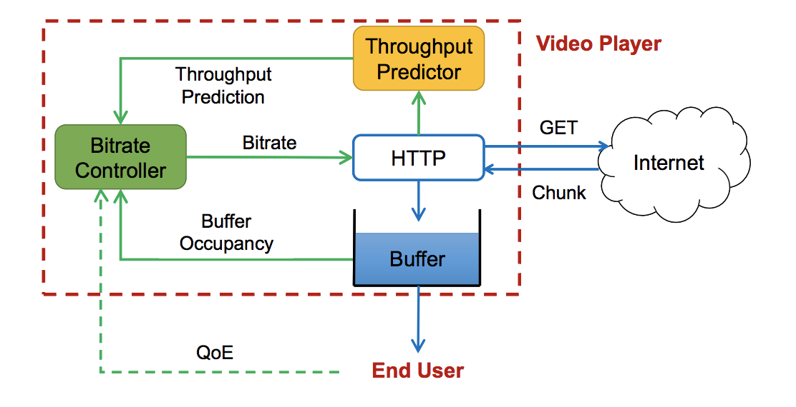
Dynamic Adaptive Streaming over HTTP (DASH)
Video is stored in chunks (few seconds each) at different discretized bitrates (240p, 360p, 720p…) at the server
DASH: get the next chunk at an “appropriate” bitrate
Notes:
Draw chunks

Slide 6
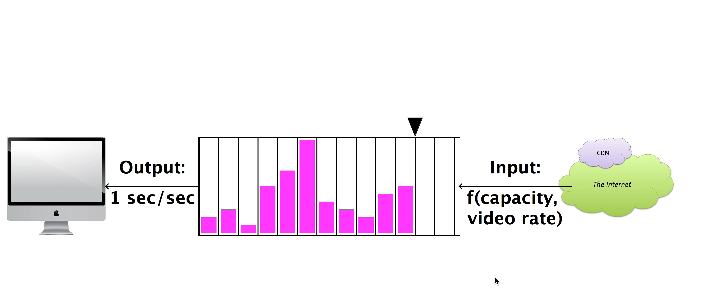



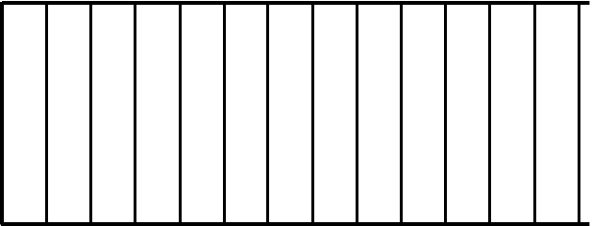

Dynamic Adaptive Streaming over HTTP (DASH)
Request:
next video chunk at bitrate r
Output
1 sec/sec
Input
Response:
video content
bitrate
1 sec
video
content
Video Client
Video Server
What happens if we select bitrate larger than throughput?
What about bitrate lower than throughput?
Goal: choose bitrate = throughput
Notes:
Highest bitrate -> rebuffer
Lowest bitrate -> Bad quality
“Best” bitrate -> Hard to bredit

Slide 7
Adaptive Bitrate (ABR) Algorithms
Want to adapt bitrate to network conditions
bitrate

Slide 8
QoE Goals
Notes:
What are the goals? Let’s see how we might be able to achieve these goals?
Minimizing rebuffering events where the playback buffer is empty and cannot render the video
Delivering as high playback rate as possible within the throughput constraints
Minimizing startup delay so that the user does not quit while waiting for the video to load
Keeping the playback as smooth as possible by avoiding frequent or large bitrate jumps

Slide 9
QoE Goals
Minimizing rebuffering
Delivering as high playback rate as possible
Minimize startup delay
Keeping the playback as smooth as possible
Notes:
Minimizing rebuffering events where the playback buffer is empty and cannot render the video
Delivering as high playback rate as possible within the throughput constraints
Minimizing startup delay so that the user does not quit while waiting for the video to load
Keeping the playback as smooth as possible by avoiding frequent or large bitrate jumps

Slide 10
ABR algorithms
Notes:
+ opportunistic, - rebuffers if throughput unexpected
+ minimize rebufferring – too conservative (low bitrate) and ignores improved throughput condistions
+ best of both worlds – hard to predict

Slide 11
ABR algorithms
Rate-based: pick bitrate based on predicted throughput
Pick highest possible bitrate based on predicted throughput
Pros? Cons?
Buffer-based: pick bitrate based on buffer occupancy
Try to keep buffer at a constant level
Pros? Cons?
Hybrid: use both throughput prediction & buffer occupancy
Learning-based: pick bitrate by learning from past experiences
Notes:
+ opportunistic, - rebuffers if throughput unexpected
+ minimize rebufferring – too conservative (low bitrate) and ignores improved throughput condistions
+ best of both worlds – hard to predict

Slide 12
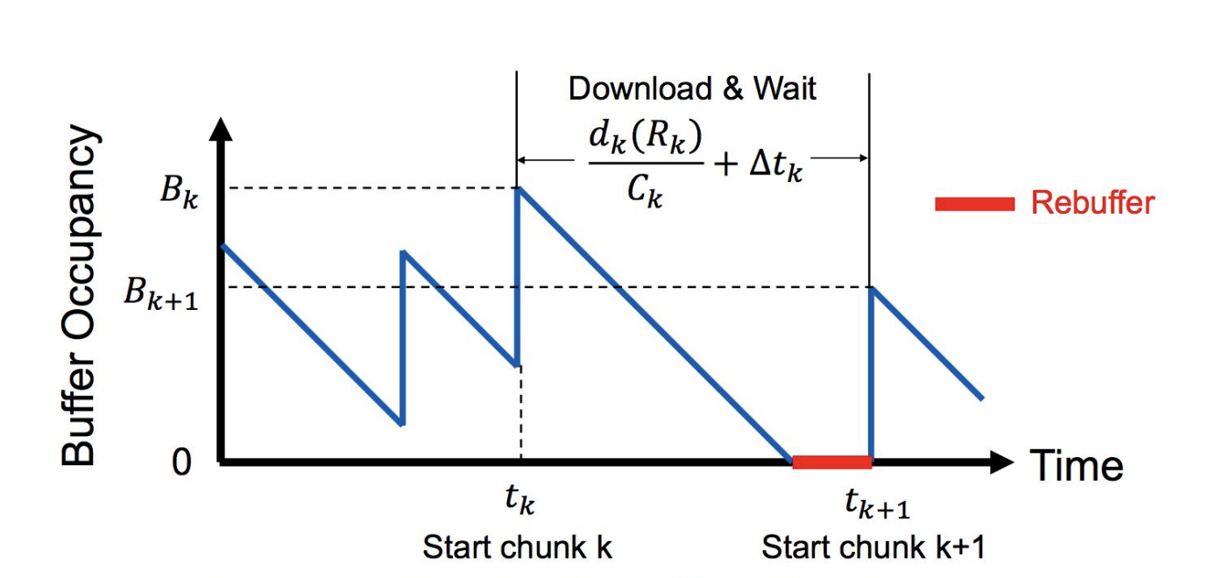
Defining QoE based on Goals
Minimizing rebuffering
Delivering as high playback rate as possible
Minimize startup delay
Keeping the playback as smooth as possible

Slide 13
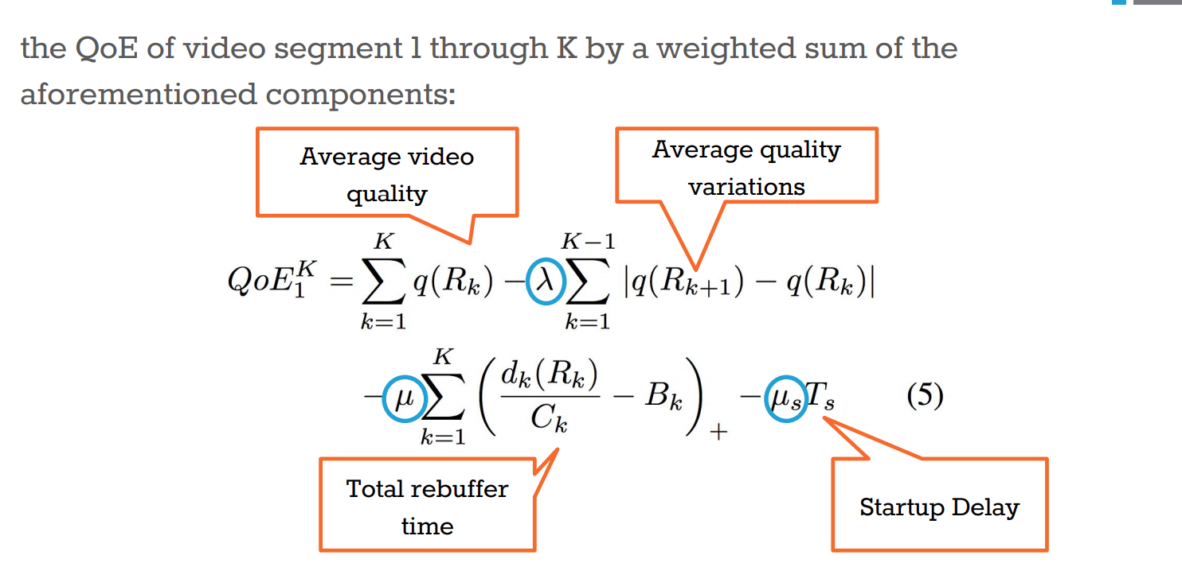
Defining QoE based on Goals

Slide 14
Solve a Maximization Problem

Slide 15
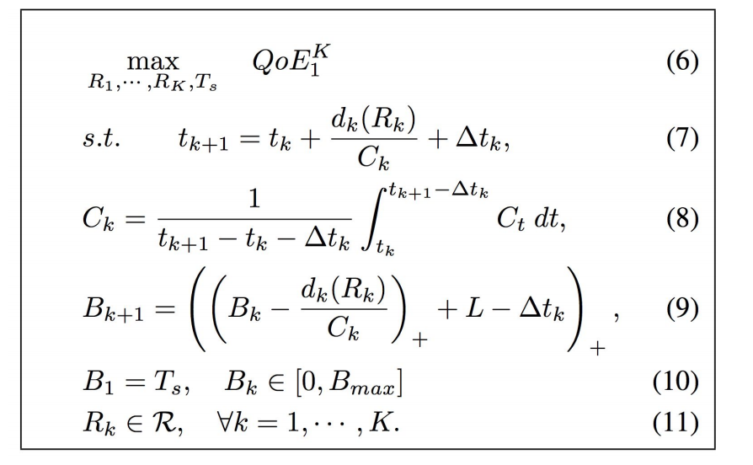
Solve a Maximization Problem

Slide 16
QoE Bitrate Adaptation Design Space

Slide 17
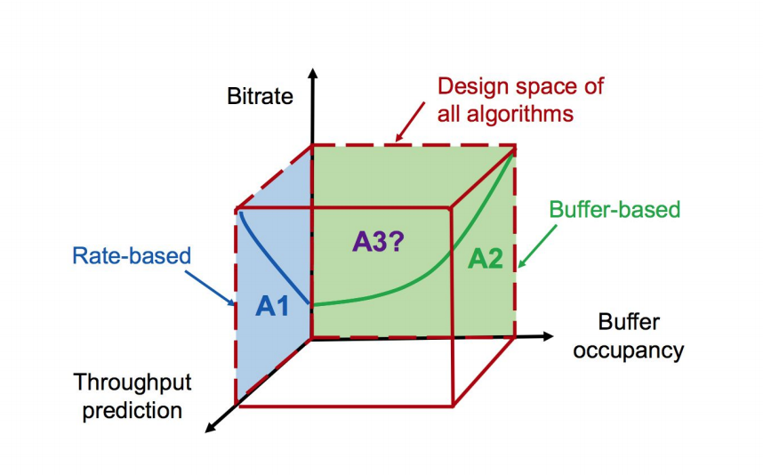
QoE Bitrate Adaptation Design Space

Slide 18
Idea: Video Adaptation using Model Predictive Control (MPC) [SIGCOMM’15]
Algorithm sketch:
Predict throughput
Solve optimization function to determine best bitrate
Repeat

Slide 19
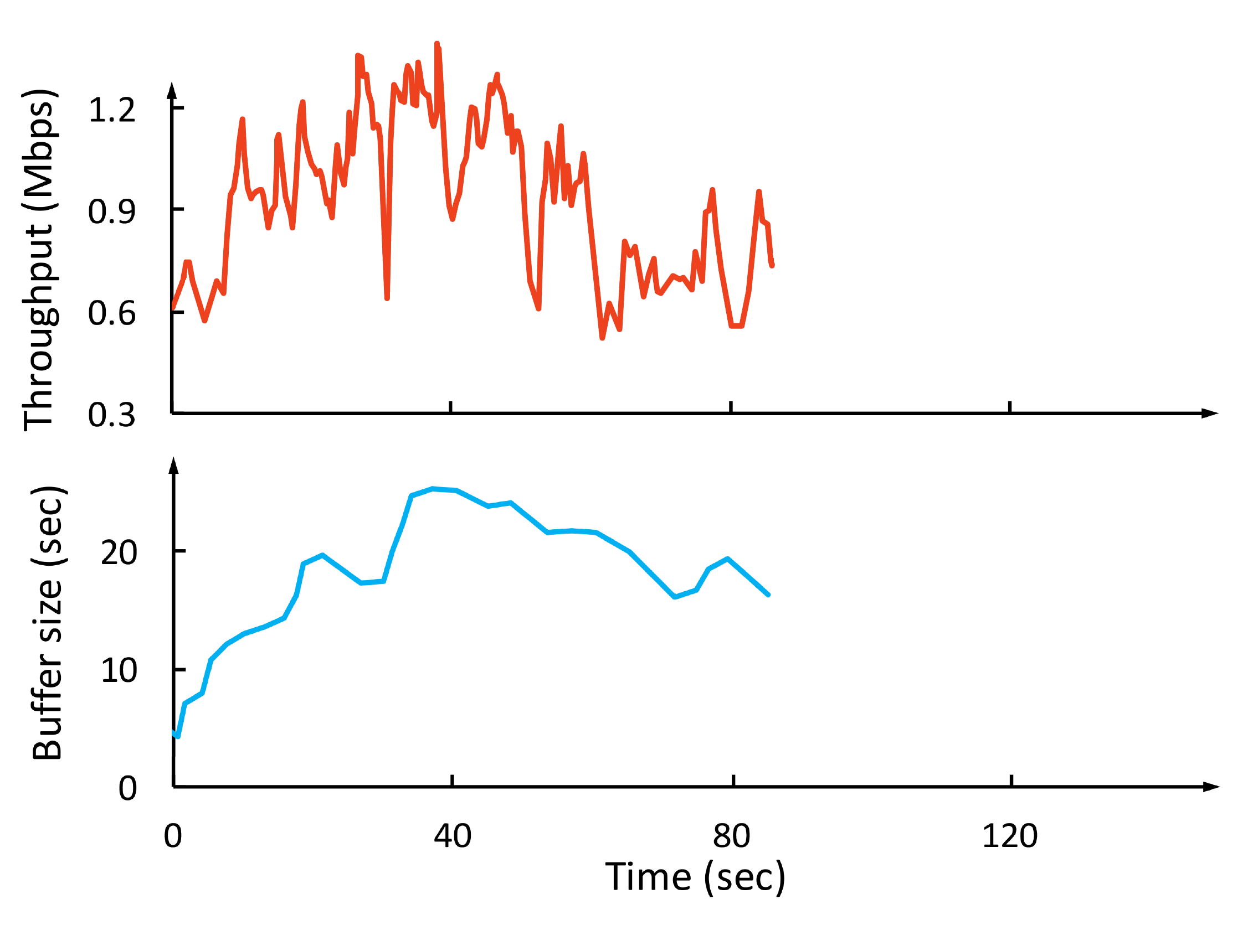
Why is Model-based ABR Challenging?
Throughput
Throughput
Bitrate
(Mbps)
Video bitrate
Buffer size
(sec)
Simplified inaccurate model leads to suboptimal performance

Slide 20
Example: Model Predictive Control
Solution: learn from video streaming sessions
in actual network conditions
t
t + T
Throughput
maximize QoE (t, t + T)
subject to system dynamics
Throughput
Bitrate
(Mbps)
Conservative Throughput
Prediction
Video bitrate
Buffer size
(sec)
Problem: Needs accurate throughput model

Slide 21
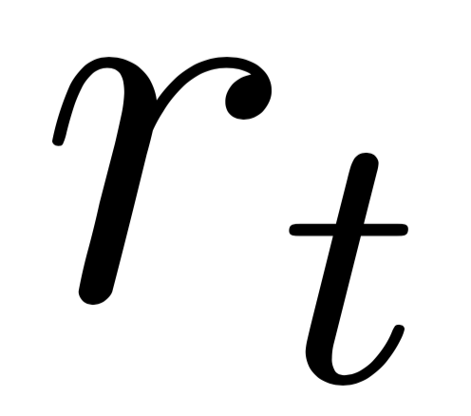
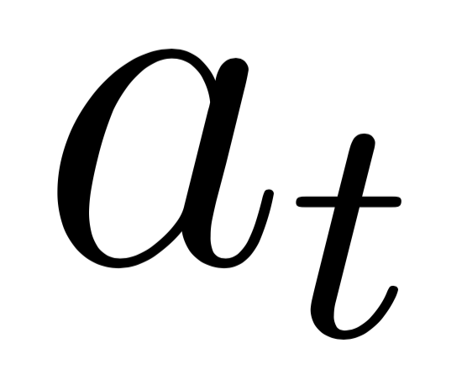
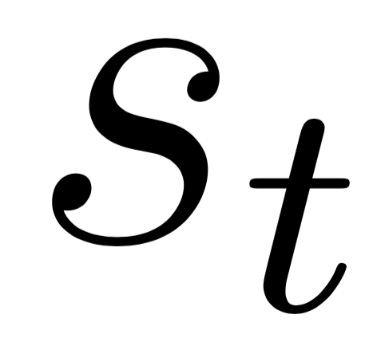
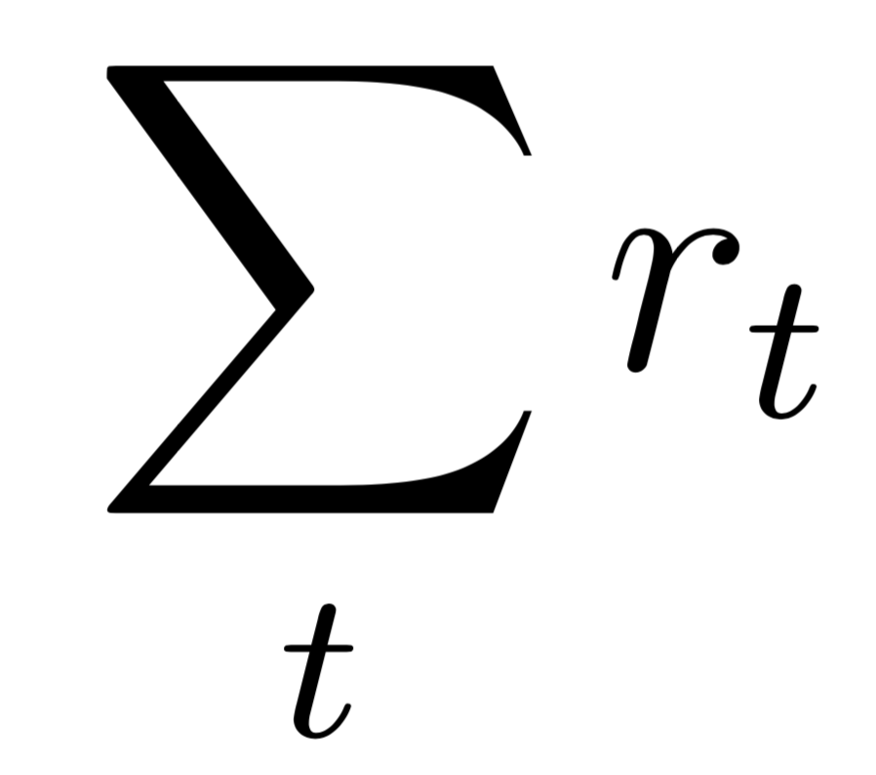
Reinforcement Learning
Reward
Agent
Environment
Take action
Observe state
Goal: maximize the cumulative reward

Slide 22

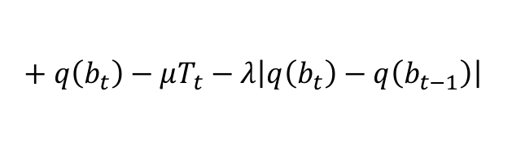
Pensieve Design
Reward
Reward r_{t}
State
Agent
$$+ q\left(b_{t}\right)−μT_{t}−λ\left|q\left(b_{t}\right)−q\left(b_{t−1}\right)\right|$$
+ (bitrate) - (rebuffering) - (smoothness)
240P
Environment
Action a_{t}
360P
Action
720P
720P
1080P

Slide 23
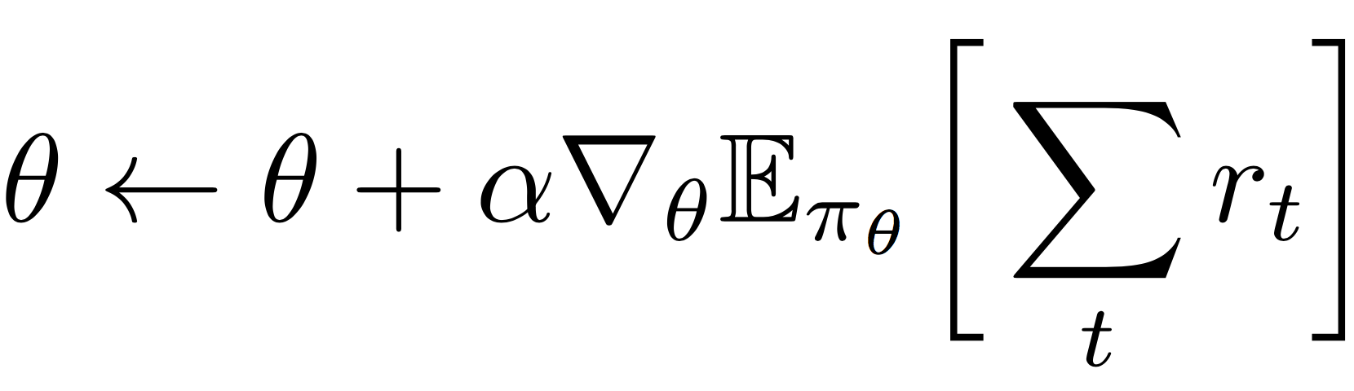
How to Train the ABR Agent
ABR agent
policy
π_{θ}(s, a)
Neural Network
240P
state
Observe state s
480P
Take action a
next bitrate
720P
1080P
parameter θ
Collect experience data: trajectory of [state, action, reward]
Training:
estimate from
empirical data

Slide 24
What Pensieve is good at
Learn the dynamics directly from experience
Optimize the high level QoE objective end-to-end
Extract control rules from raw high-dimensional signals

Slide 25

Pensieve Training System
Large corpus of
network traces
cellular, broadband, synthetic
Video playback
Fast chunk-level simulator
Model update
TensorFlow
Pensieve worker
{state, action, reward}
experiences
Pensieve worker
Pensieve master
updated neural
network parameters
Pensieve worker

Slide 26
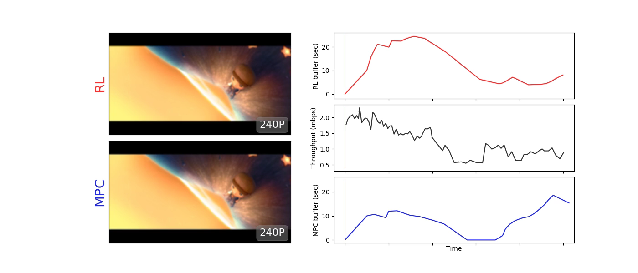
Demo
Pensieve buffer (sec)
Pensieve
chances of outage
Throughput (mbps)
Rebuffering
MPC
MPC
buffer (sec)

Slide 27
Trace-driven Evaluation
Dataset: Two datasets, each dataset consists of 1000 traces, each trace 320 seconds.
Video: 193 seconds. encoded at bitrates: {300, 750, 1200, 1850, 2850, 4300} kbps.
Video player: Google Chrome browser Video server: Apache server
Norway 3G cellular dataset
FCC broadband dataset
better
better
Pensieve improves the best previous scheme by 12-25%
and is within 9-14% of the offline optimal

Slide 28

QoE Breakdown
better
better
better
Pensieve reduces rebuffering by 10-32% over second best algorithm
Reward/QoE
+ Bitrate utility – rebuffering penalty – smooth penalty

Slide 29
Challenge: Why separate networking protocol from compression and ABR?
Wireless Video that Scales Gracefully with SNR
Idea: combine compression and modulation/networking
Encode the real-valued content directly over the transmitted signal
Amplitude Modulation
OFDM-based Amplitude modulation

